Slide 1

Credit Card Reward Maximizing App
“ChaChing”
By Jun, Ben, Oliver, Kayvon, and Sarah

Slide 2

Introduction of the coolest members
Jun Won ( Team Leader)
Ben Smith (Tech Leader)
Oliver McMillen
Kayvon Hemati
Sarah Jiamjan

Slide 3
System Scope:
The Android app project aims to leverage US domestic credit card information for calculating maximum rewards. Users can categorize purchases and select preferred reward systems.
Users can save, delete, and manage credit cards within their profile. The app will notify users when credit cards are nearing expiration, and it includes a user-friendly navigation menu for easy access to different sections.=
This comprehensive system allows users to optimize credit card rewards and conveniently manage their cards through categorization, notifications, and effective user profile control. Additionally, the app tracks and displays accumulated points for each card since the first download.

Slide 4
Features:
User can categorize the type of purchase they make and choose the preferred reward system.
Notify the user when the card nearing the expiration date.
Ability to save and delete cards to the user profile.
Navigation Menu.
Accumulation of points accrued for each card saved to user profile since first download of application.

Slide 5
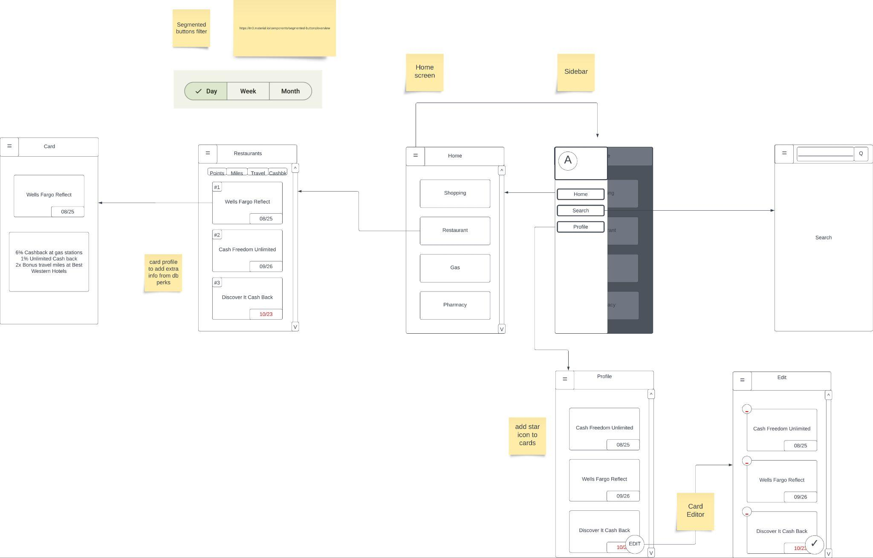
UI
Diagram

Slide 6
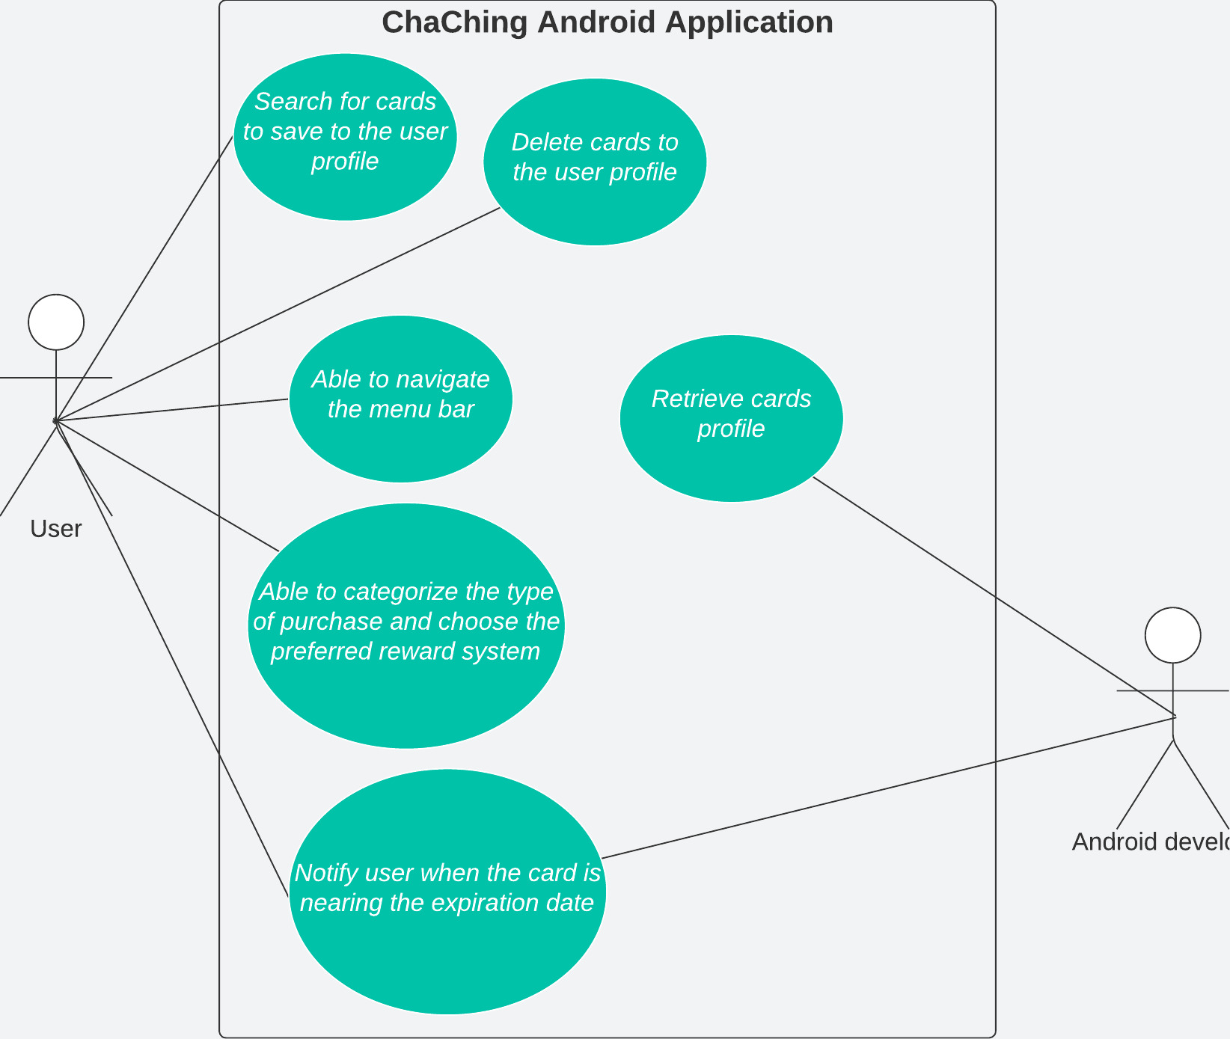


Use
Case
Diagram

Slide 7
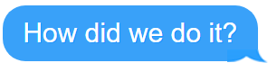

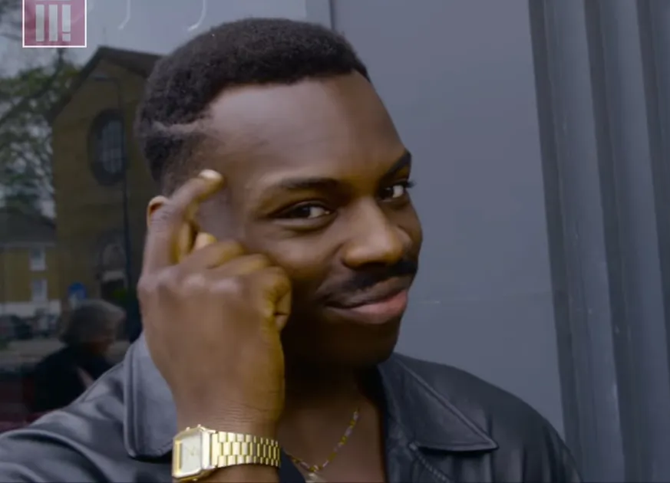
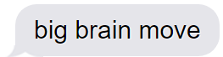
Project Management
Structure

Slide 8
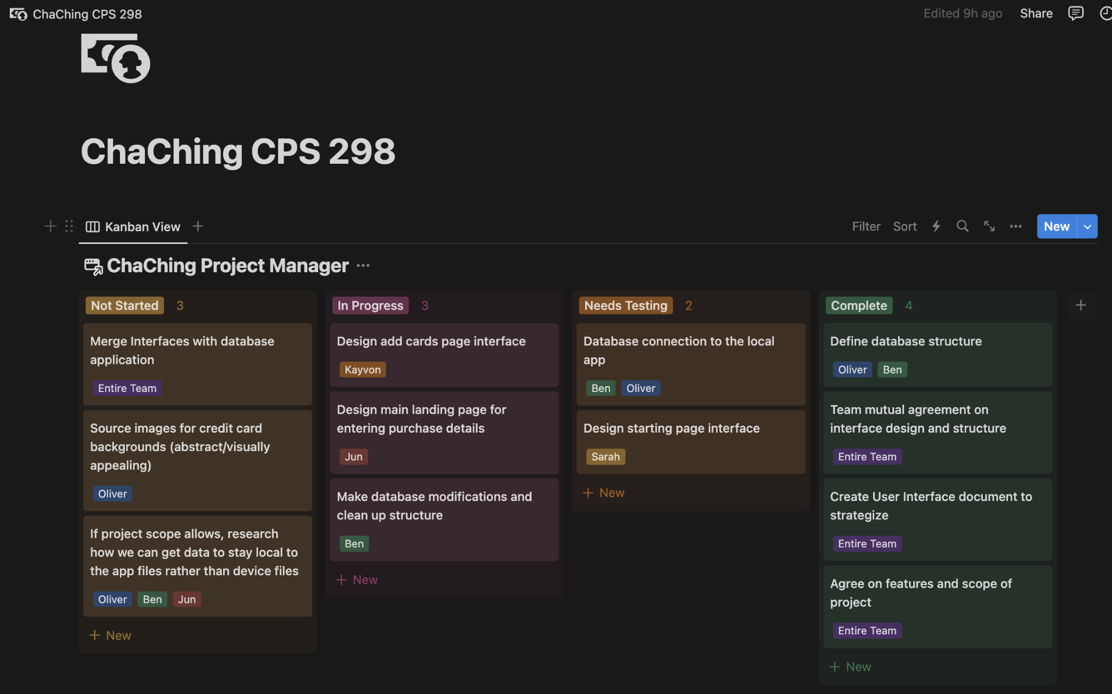

Slide 9
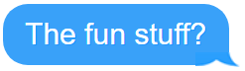


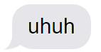
Database Structure

Slide 10
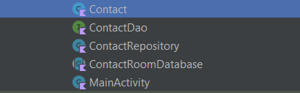
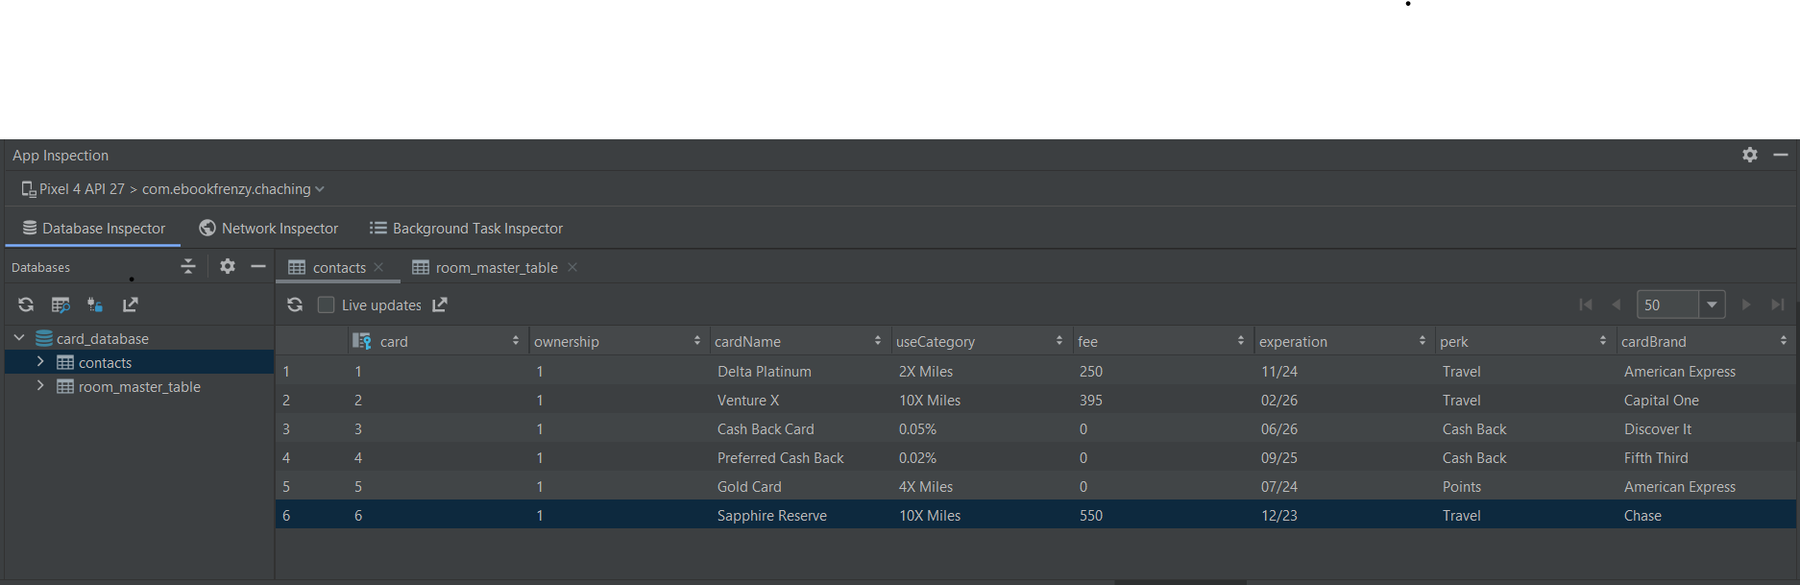
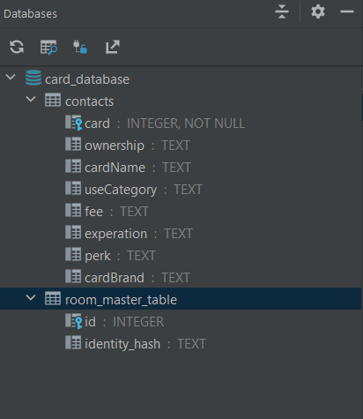
Classes:
Entities:
Informations stored in each entity:

Slide 11
Example of the database:

Slide 12

Time to demonstrate our app…

Slide 13


Slide 14

Conclusion

Slide 15
What was our struggles?
Syncing database and the User Interface
Making sure that the navigation bar is taking us to the right fragment
Making sure that the application runs on our local machines
Making sure that all the data(after inputting) are stored in the proper place in the database

Slide 16
Improvement?
Includes other credit cards that are not US-based
Have a more intuitive User Interface
Includes a user guide on the application
Makes sure that the application is consistent and secure

Slide 17
What did we learn?
Learned how to use team github
Learned how to collaborate with other team members
Learned how to reach out to other team members when we needed
Learned how to be creative with new ideas

Slide 18

That’s it
It was great working with you guys

